Slide 2
Linear and Logistic Regression
Anas Abuelhaag

Slide 3
Workshop Overview
Introduction to Linear Regression
Introduction to Logistic Regression
Tools and Setup
Practical Examples using Real Data

Slide 4
What is Linear Regression?
Linear Regression is a method to predict a dependent variable (y) based on one or more independent variables (x).
Daily Life Simile: Imagine predicting your monthly electricity bill based on the number of appliances you use. More appliances, higher the bill - it’s a straight-line relationship.

Slide 5
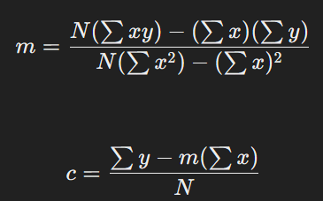
Equation:
y = mx + c
y is the dependent variable.
x is the independent variable.
m is the slope of the line.
c is the y-intercept.

Slide 6
What is Logistic Regression?
Logistic Regression is used for binary classification problems, predicting outcomes like yes/no, pass/fail.
Daily Life Simile: Think of predicting whether you'll get a job based on your interview performance. There are only two outcomes - either you get the job or you don't.

Slide 7


Slide 8
Jupyter
Jupyter Notebooks allow for interactive coding and visualization.
You can write code, run it, and see the results all in one place.
Great for data analysis and machine learning.

Slide 9
Scikit-learn
scikit-learn is a powerful, open-source machine learning library for Python.
It provides simple and efficient tools for data mining and data analysis.
Built on top of NumPy, SciPy, and matplotlib, scikit-learn is designed to interoperate seamlessly with these libraries.

Slide 10
Scikit-learn
Classification
Regression
Clustering
Dimensionality Reduction
Model Selection
Preprocessing

Slide 11

Take our two-question survey

